Slide 1

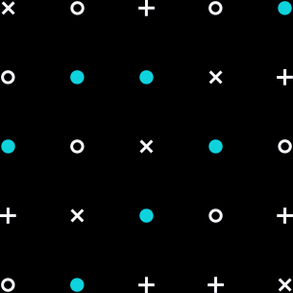

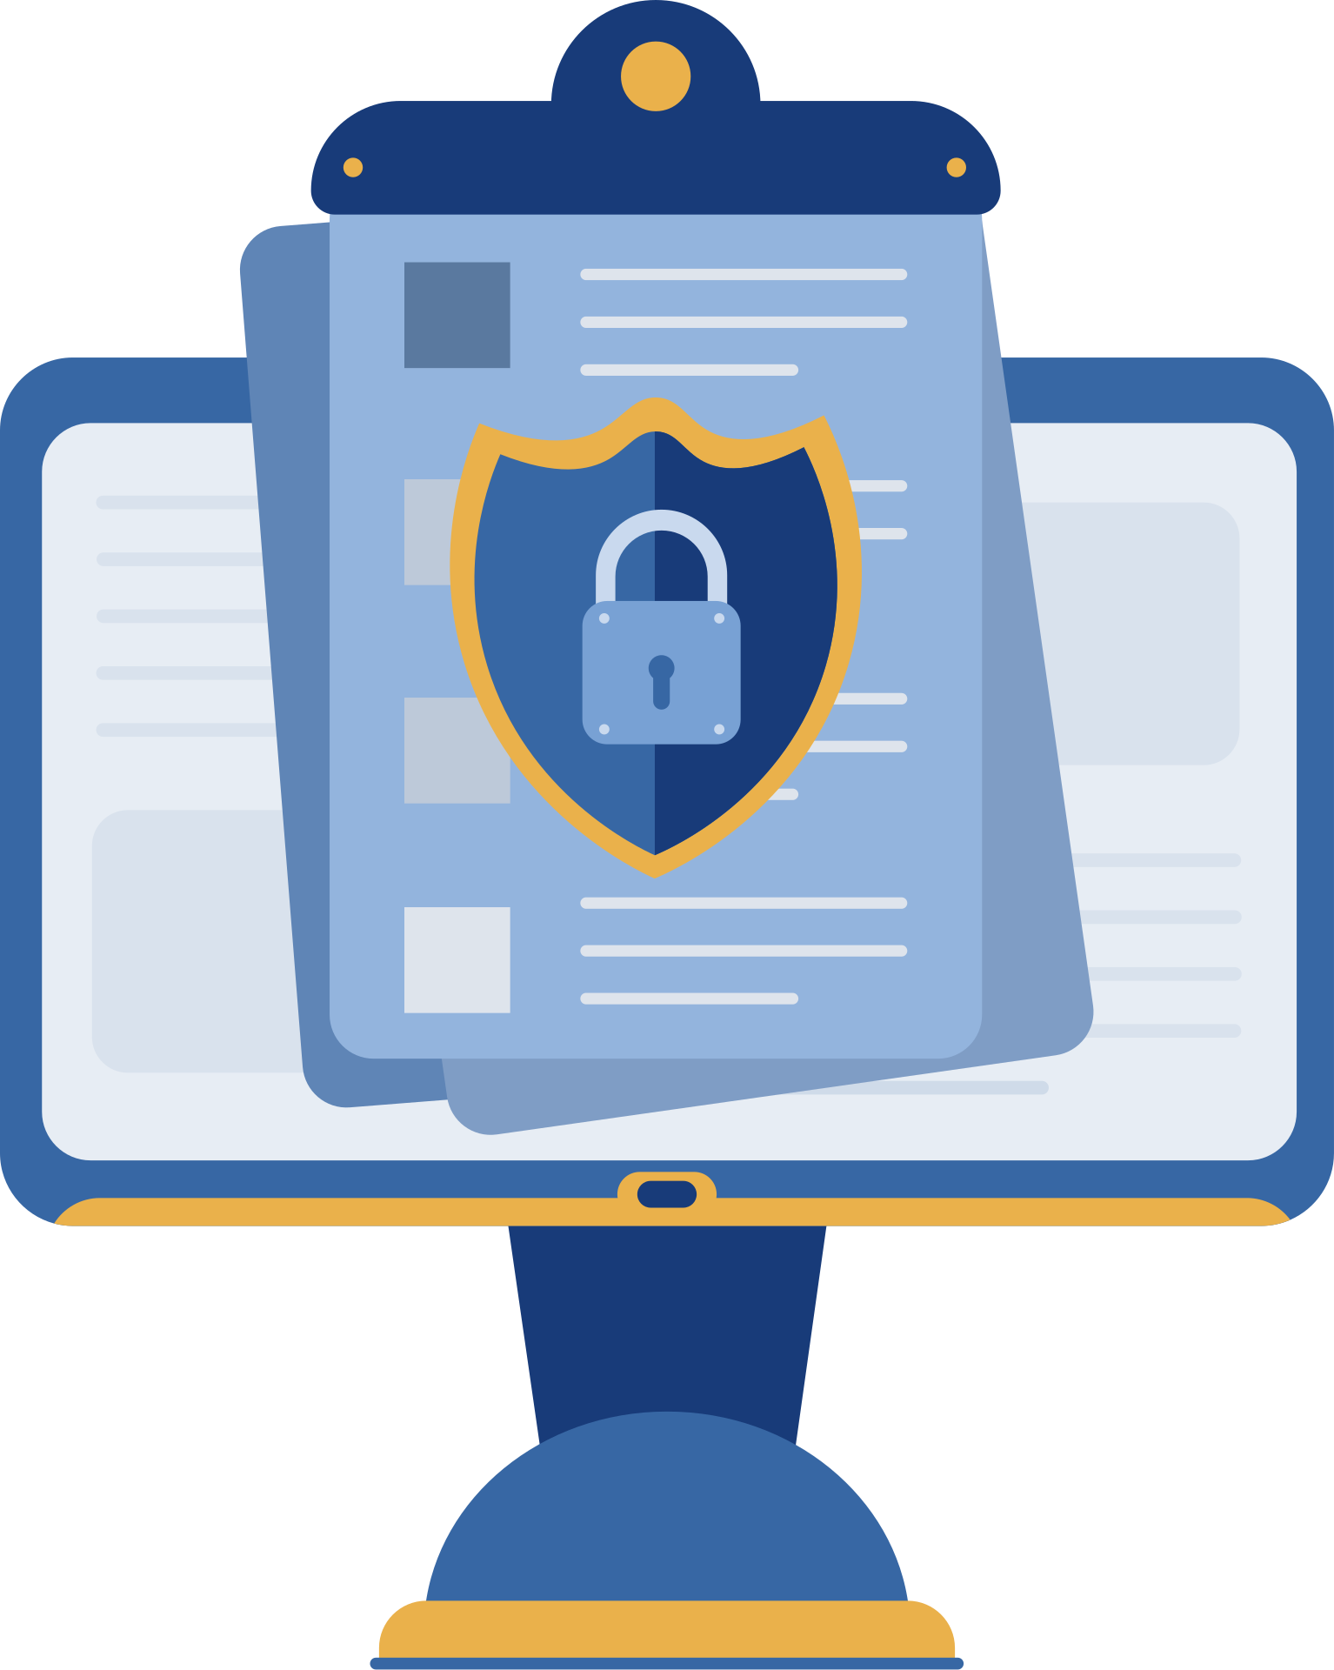

PASSWORD PERSONALITY PROFILER
Safeguarding Our Digital World

Slide 2

Meet Your Passwords — And What They Say About You
Welcome! This project is all about understanding the hidden stories your passwords tell. The Password Personality Profiler is a tool that analyzes the way people create passwords and connects that to their behavior, habits, and awareness of digital security.

Slide 3
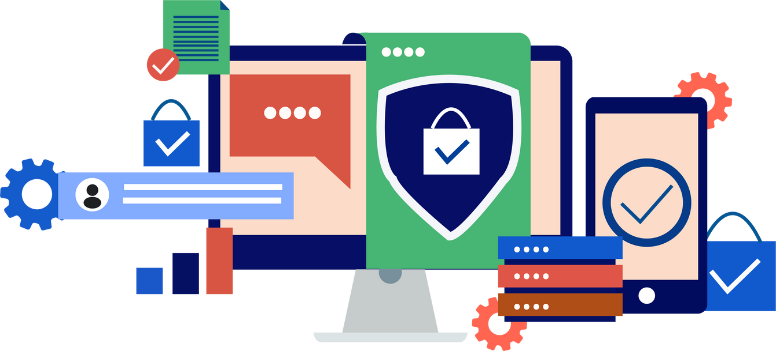
Why This Project Matters
In today’s world, passwords are more than just keys to our accounts — they’re reflections of how we think and how much we care about security. Unfortunately, many people still rely on weak, reused, or overly personal passwords. This tool aims to bridge the gap between awareness and action.

Slide 4
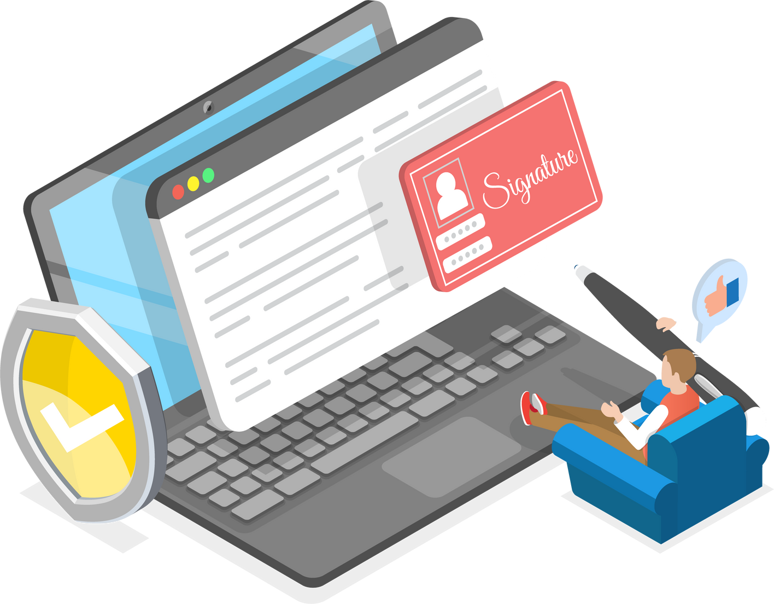
What’s the Real Problem?
Despite being warned, many users continue to create predictable or emotional passwords — often including names, birth years, or common phrases. Most existing password checkers only show “strong” or “weak,” but none help users reflect on their actual behavior.

Slide 5
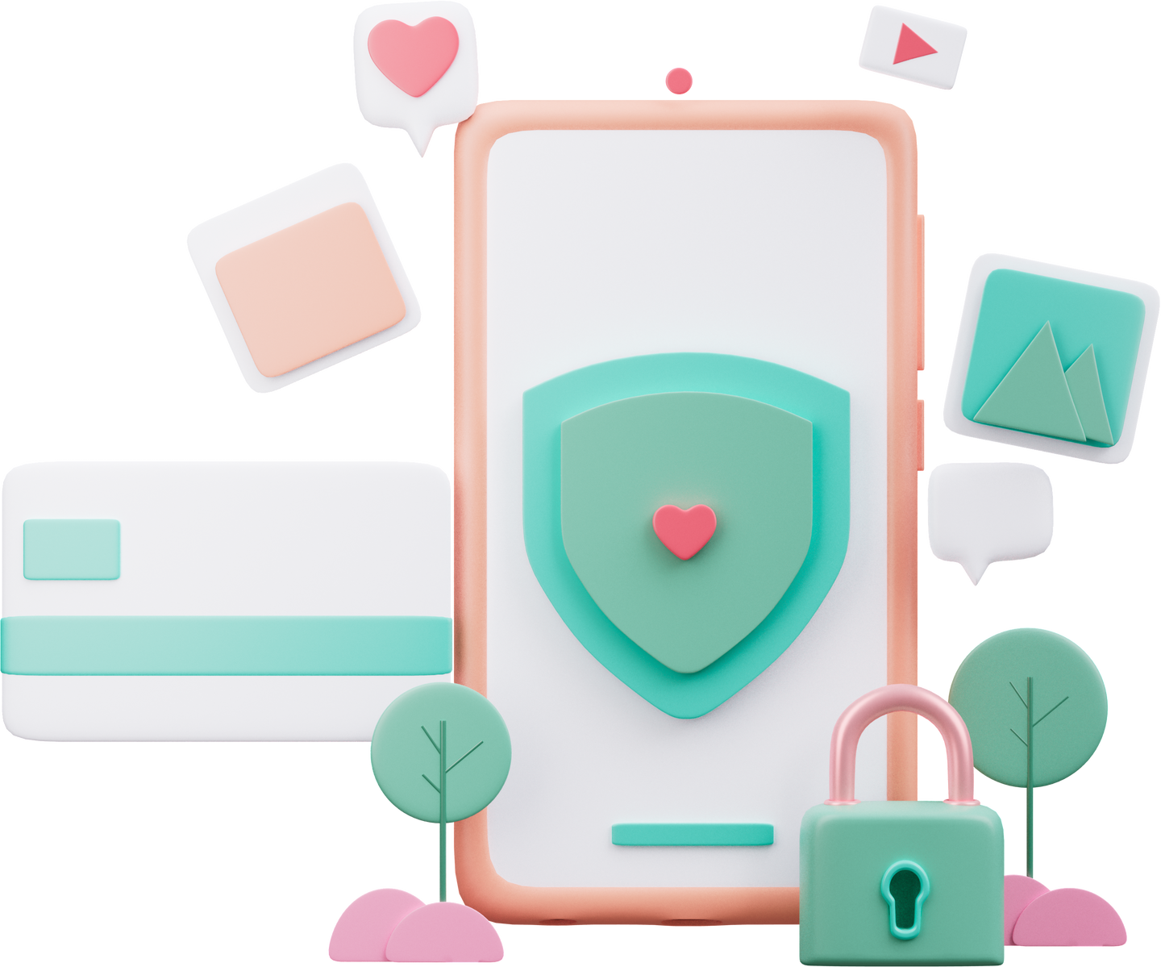
Our Mission: Understand, Reflect, Improve
The goal was simple yet powerful: give users a way to input sample passwords, analyze the patterns, detect potential risks, and finally provide a personality-based profile that makes the learning experience fun, relatable, and insightful.

Slide 6
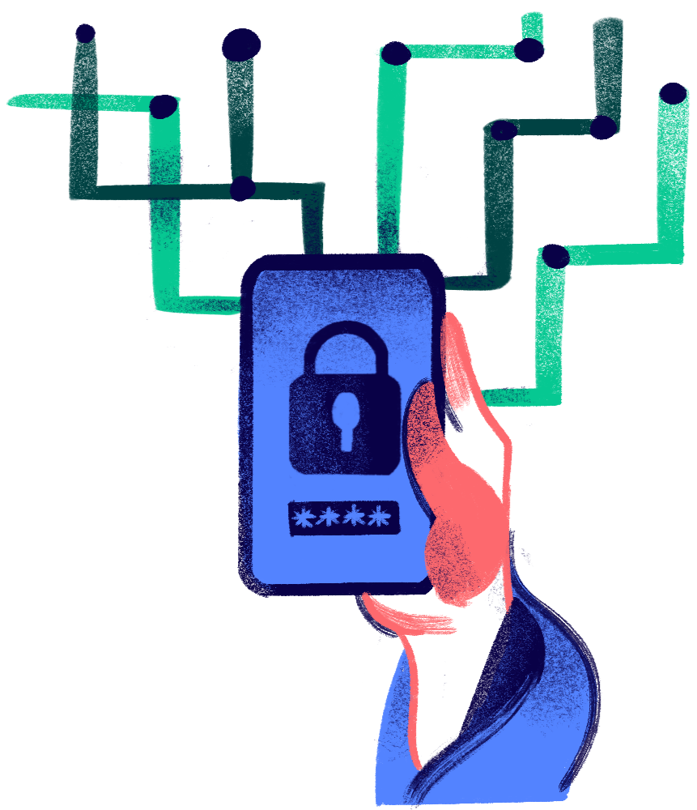
User Input & Sample Collection
The user begins by entering 3 to 5 sample passwords into the tool—these are not real passwords, but examples that reflect how they usually create passwords. This step helps capture the user’s typical password behavior without compromising their security or personal data.
Behind the Scenes — How It Works
Pattern Analysis Using Regex & Scoring
Once the inputs are submitted, the tool uses regular expressions (regex) to scan each password for known patterns—such as the presence of names, years, common words, symbols, and length. Based on the traits found, each password is assigned a score that reflects its strength, predictability, and emotional content.
Profile Generation & Feedback
After analyzing all sample passwords, the system calculates an overall behavioral profile such as “The Careless User” or “The Overthinker.” It then displays this personality type along with customized suggestions to improve the user’s password strategy, making the experience both educational and personal.

Slide 7




Numbers & Birth Years
Repeated Words or Patterns
We detect 4-digit numbers like 1999 or 2003, which often represent birth years or anniversaries — a common emotional habit and a major security risk.
Passwords like "hello123", "qwerty", or "abcabc" are flagged for predictability. Repetition is easy to remember — and easy to crack.
What We Look For (and Why It Matters)
Personal Keywords
Strength Factors
We scan for names, pets, places, or favorite words (e.g., “iloveyou”, “papa@2020”) that reveal emotional ties — making the password easier to guess.
We reward passwords with symbols (!, @, #), uppercase/lowercase mix, and length (10+ characters), which show conscious effort toward stronger security.

Slide 8
What We Discovered
❤️
😅
🎨
🧠
The Careless
Users reused weak passwords like admin123. Easy, but risky
The Emotional
Passwords included names, dates, or personal words. Sentimental, yet predictable
The Creative
Used symbols, mixed cases, and long strings. Strong and thoughtful.
The Overthinker
Very complex passwords, often hard to remember. Secure, but not practical.

Slide 9
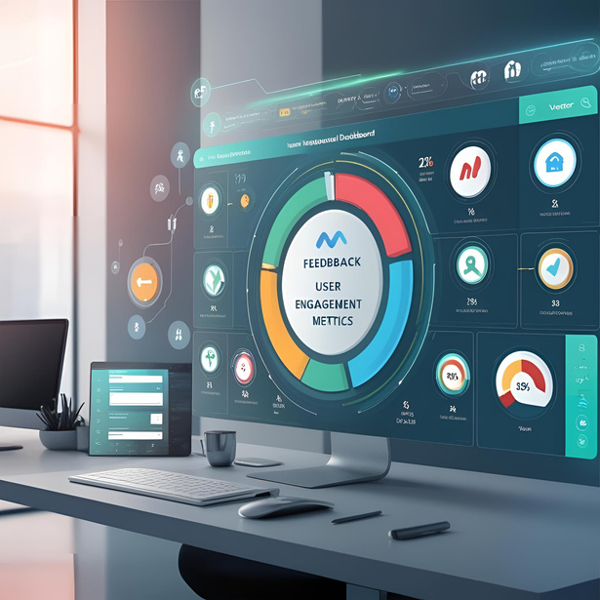
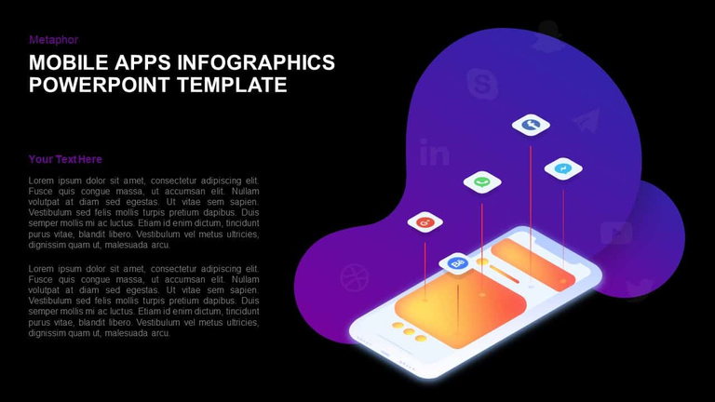
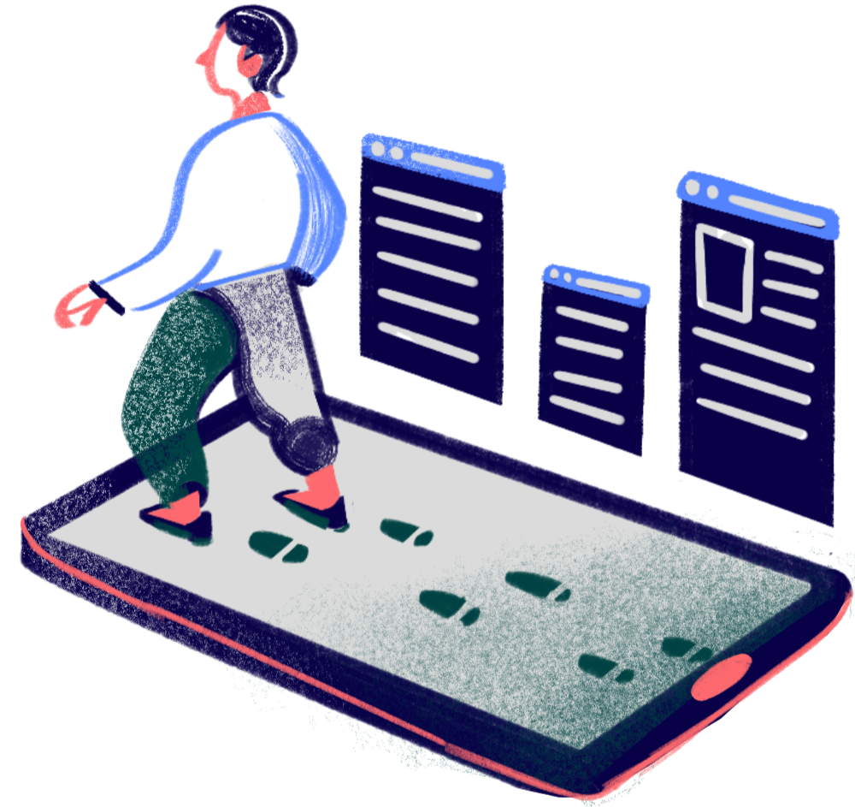
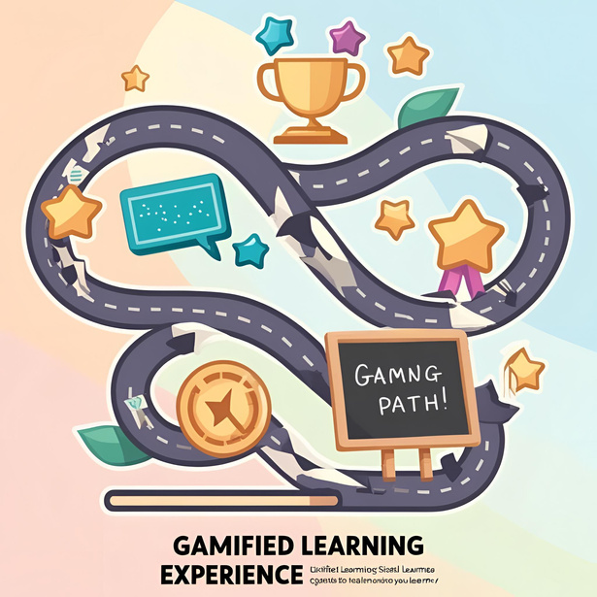
Where We’re Headed Next
Visual Dashboards for Feedback
Mobile App
Gamified Learning Experience

Slide 10
Conclusion
The Password Personality Profiler bridges the gap between cybersecurity and self-awareness. It doesn’t just tell users if a password is “strong” or “weak” — it helps them understand why they choose certain patterns, and what those choices say about their habits.
By analyzing sample passwords, the tool assigns relatable personality profiles and offers actionable advice. This makes learning about digital safety more engaging and personal.
Most importantly, the tool is private, educational, and user-friendly. It empowers users to reflect, improve, and adopt better password hygiene — making the internet a little safer, one password at a time.

Slide 11
THANK YOU!

